Slide 1
Our Project
SDWORX Hackathon 2021

Slide 2


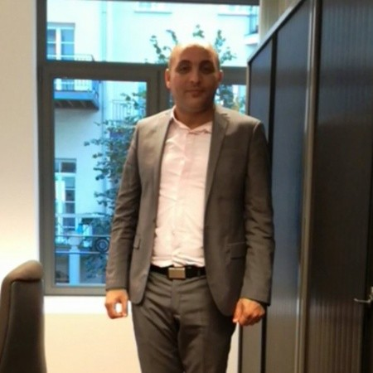
Our Amazing Team
Kevin Albert: Data Scientist
Hanna Oulad : Web developer
Bayar Mohamed : Microsoft .Net Consultant

Slide 3
What is it About ?
collecting and analysing employee feedback

Slide 4
What is it About ?
collecting and analysing employee feedback
with the goal to explain root-causes for employee engagement

Slide 5
What is it About ?
collecting and analysing employee feedback
with the goal to explain root-causes for employee engagement
technical exercise :
chatbot :
cognitive services :
graph :
machine learning :

Slide 6
What is it About ?
technical exercise : explore the possible ?
chatbot : generate survey & collect data
cognitive services : enrich data
graph : explore data relationships
machine learning : explainability

Slide 7
What is it About ?
collecting and analysing employee feedback
with the goal to explain root-causes for employee engagement
technical exercise : explore the possible ?
chatbot : generate survey & collect data
cognitive services : enrich data
graph : explore data relationships
machine learning : explainability
explain where a certain sentiment comes from ?
reasons for negative survey answers ?

Slide 8
Tools

Slide 9
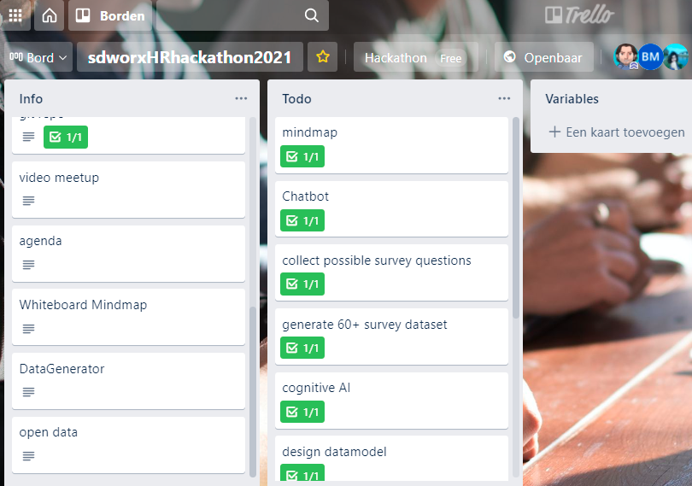
Status page
https://trello.com/b/1V3NokwO

Slide 10
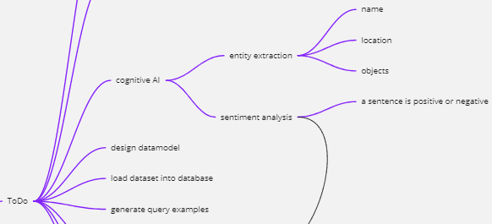
Mindmap

Slide 11
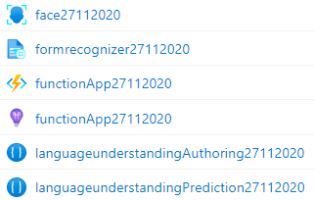
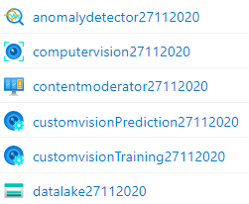
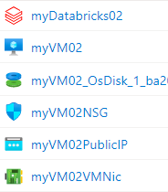
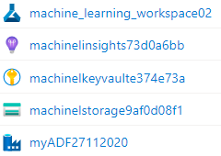
Cloud

Slide 12
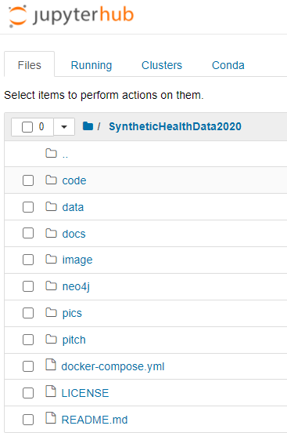
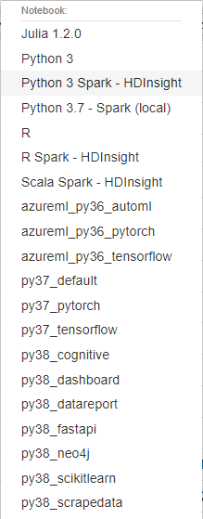
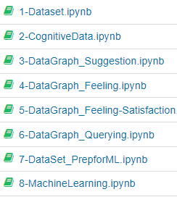
Development environment

Slide 13
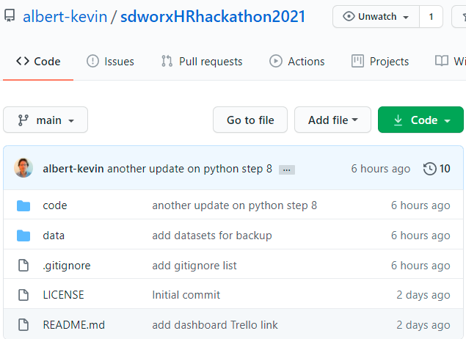
Git repo
https://github.com/albert-kevin/sdworxHRhackathon2021
https://github.com/bayarmohamed/Hackathon

Slide 14
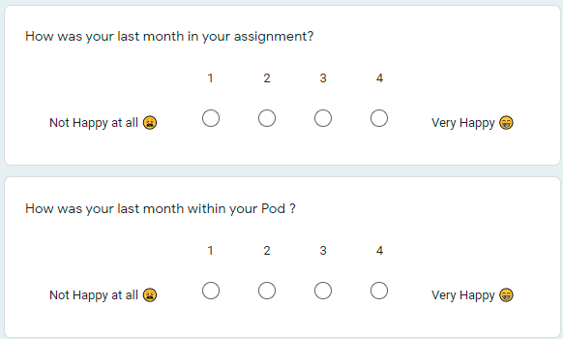
Synthetic survey data

Slide 15
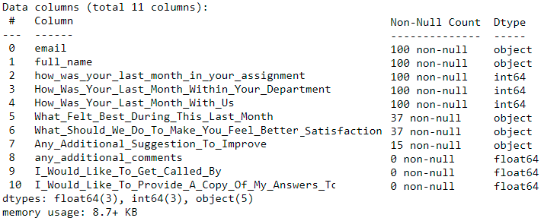
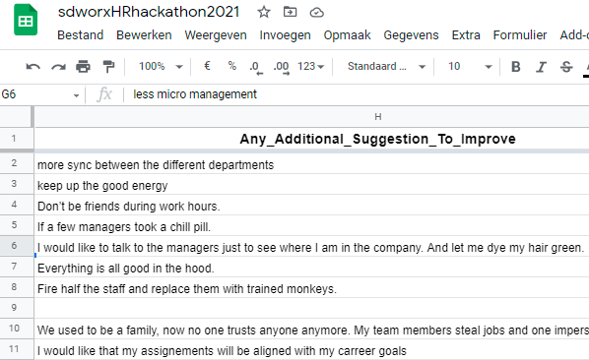
Synthetic survey data

Slide 16
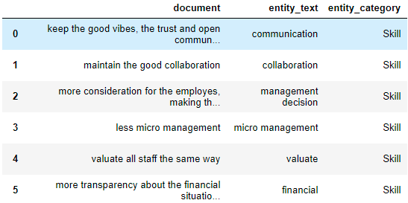
Entity extraction

Slide 17
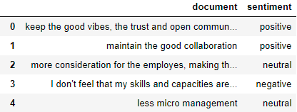
Sentiment extraction

Slide 18
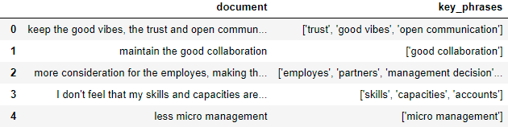
Key phrases extraction

Slide 19
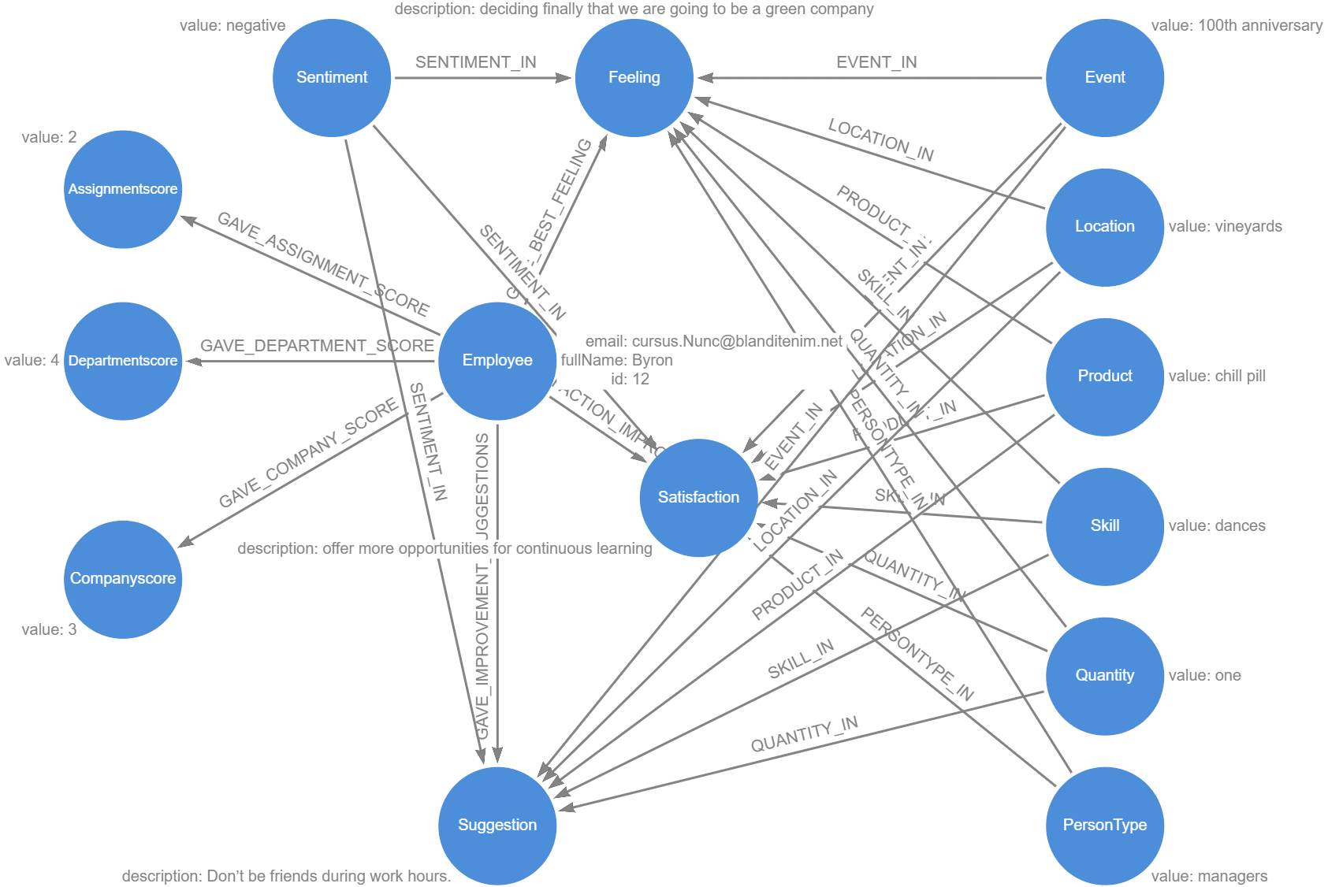
Datamodel

Slide 20
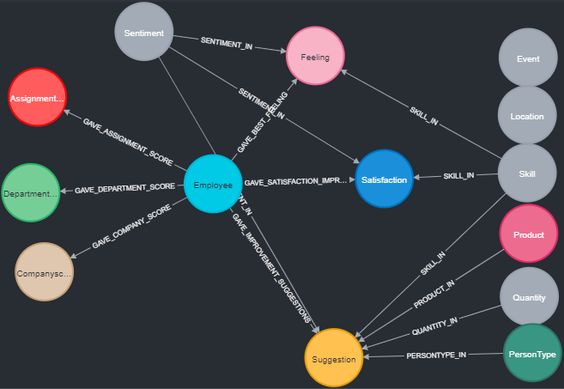
Graph database

Slide 21
Some Cool Stuff We Did

Slide 22
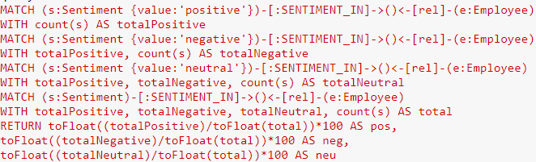
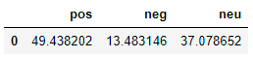
total sentiment percentage ?
what percentages has a positive, negative and neutral sentiment ?

Slide 23
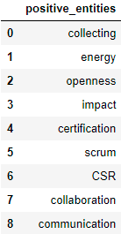
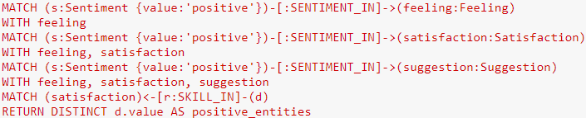
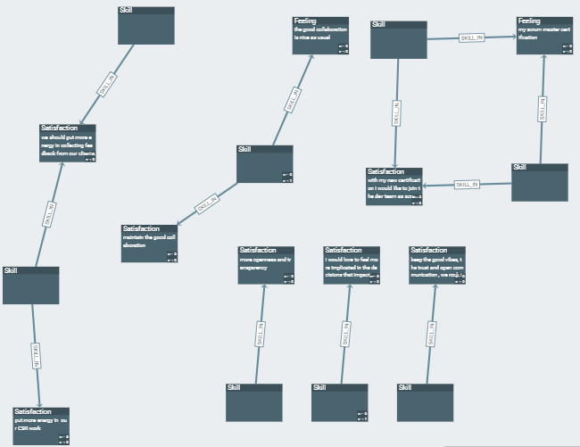
positive sentiment entity words ?
what percentages has a positive, negative and neutral sentiment ?

Slide 24
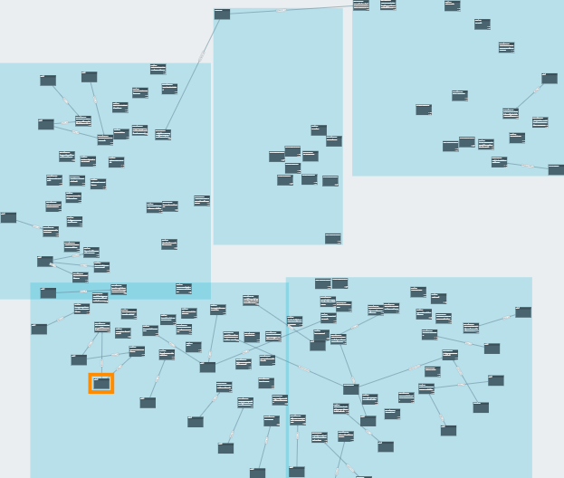
cluster ?
what percentages has a positive, negative and neutral sentiment ?

Slide 25
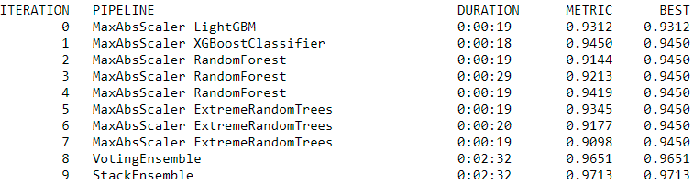
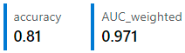
Machine Learning

Slide 26
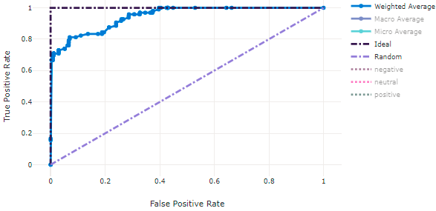
Machine Learning

Slide 27
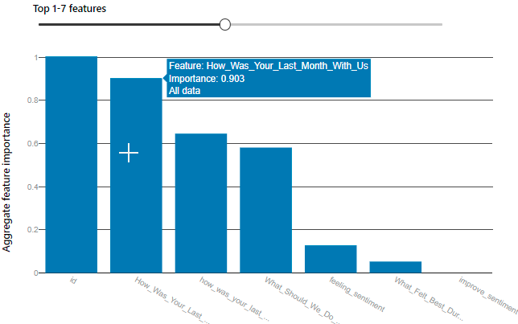
Most important Sentiment Influencer
How Was Your Last Month With Us ?
… we can explain why a cluster or a certain sentiment comes from

Slide 28
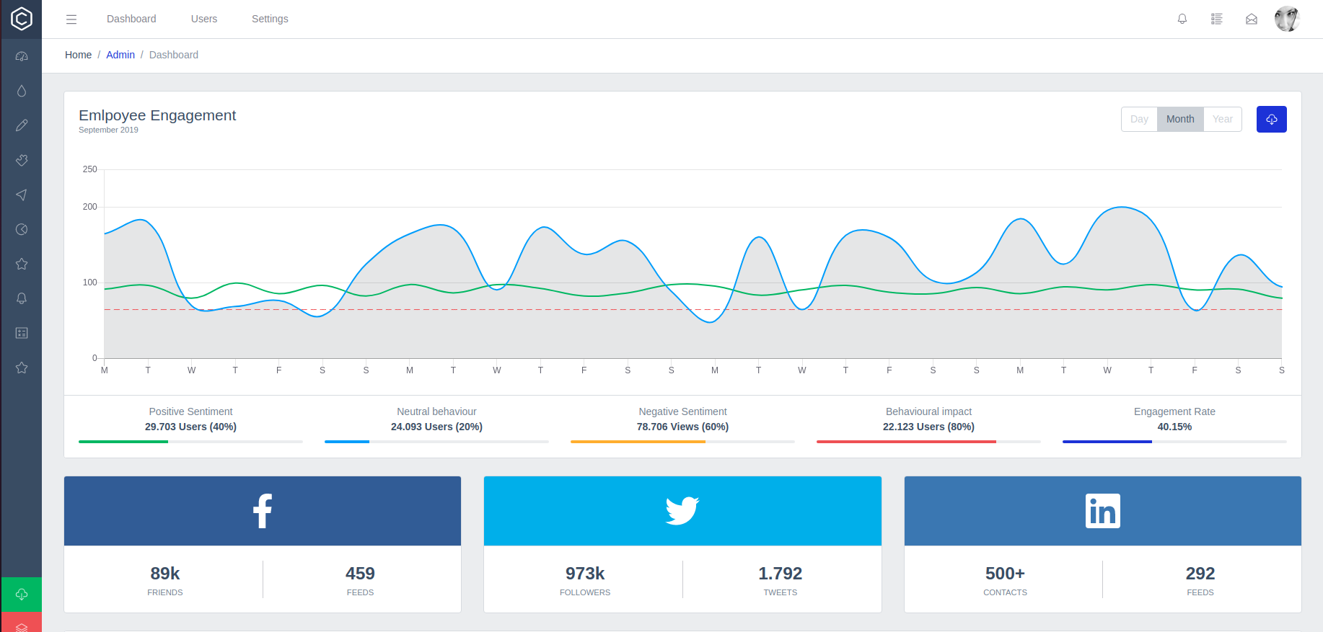
Showcasing the data treatment

Slide 29

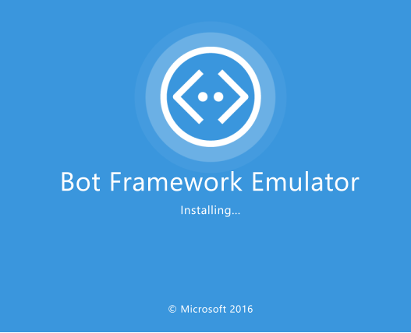



Requirements
Asp.net core web api project with
Microsoft.Bot.Builder.Integration.AspNet.Core
Bot framework Emulator
Entity Framework Core
Sql Server
adaptivecards.io web site
source code : bayarmohamed/Hackathon (github.com)

Slide 30
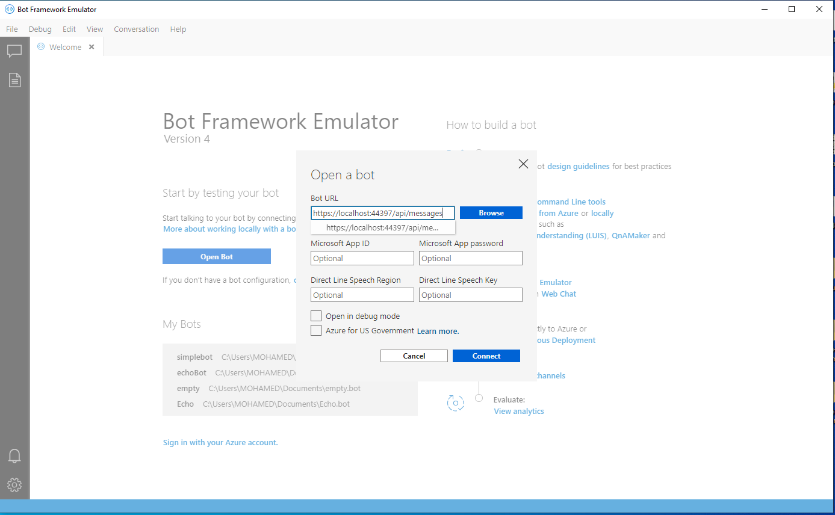
Bot Framework Emulator

Slide 31
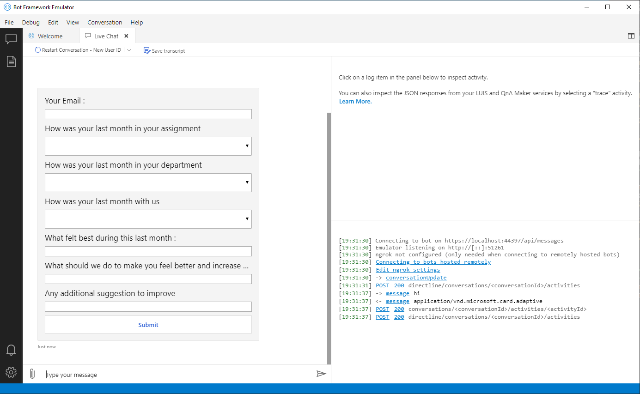
ChatBot For Survey
Use chatbot with “Adaptive Cards” SDK or json to generate a survey form

Slide 32
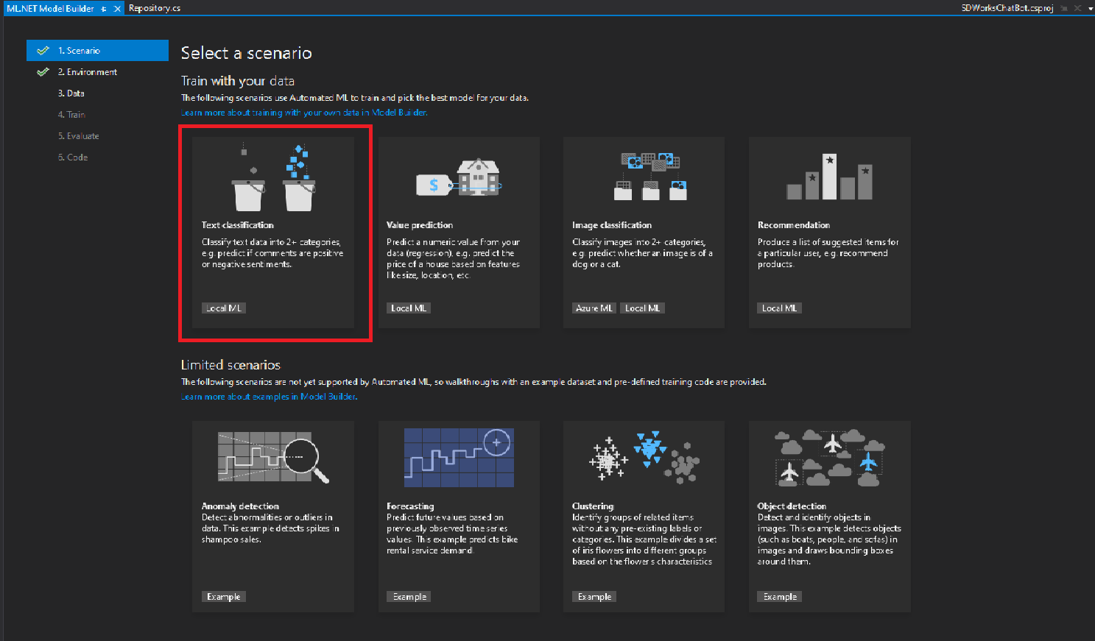
Training Data with ML.Net
Select a binary classification as a scenario

Slide 33
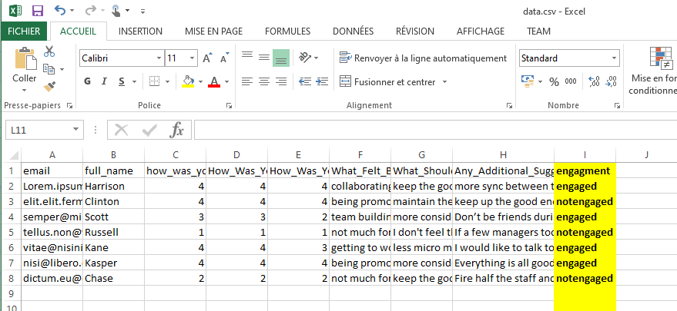
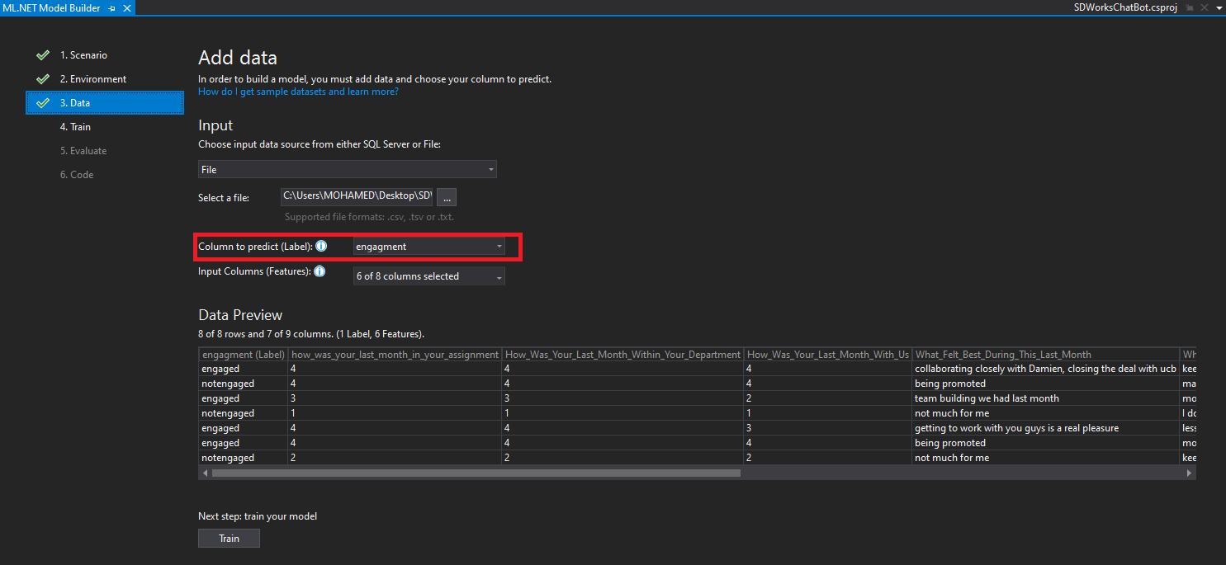
Training Data
Import Data from csv file
engagement field is a Label
Features are other fields except email and name

Slide 34
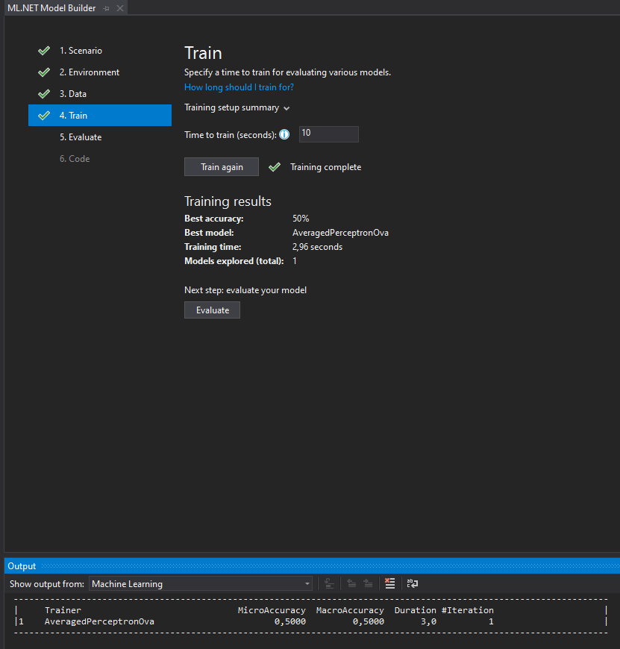
Train the model
Train : generate a model to be used to predict survey
The training select the more adapted model (best model)
In our case the AveragedPerceptronOva.
The accuracy : 50% (Accuracy is the proportion of correct predictions with a test data set. It is the ratio of number of correct predictions to the total number of input samples. It works well if there are similar number of samples belonging to each class)

Slide 35
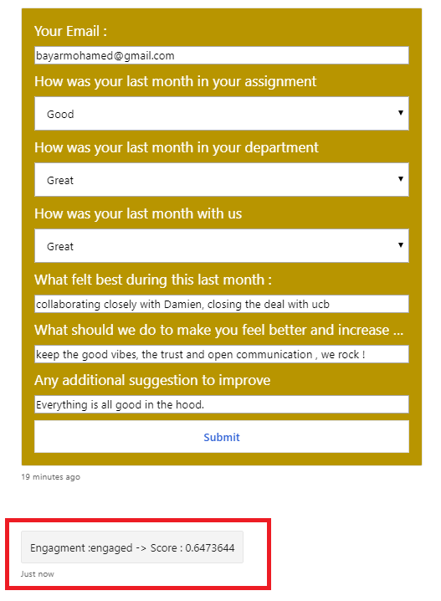
Predict the survey
F1 score also known as balanced F-score or F-measure. It's the harmonic mean of the precision and recall. F1 Score is helpful when you want to seek a balance between Precision and Recall.
The closer to 1.00, the better. An F1 score reaches its best value at 1.00 and worst score at 0.00. It tells you how precise your classifier is.

Slide 36
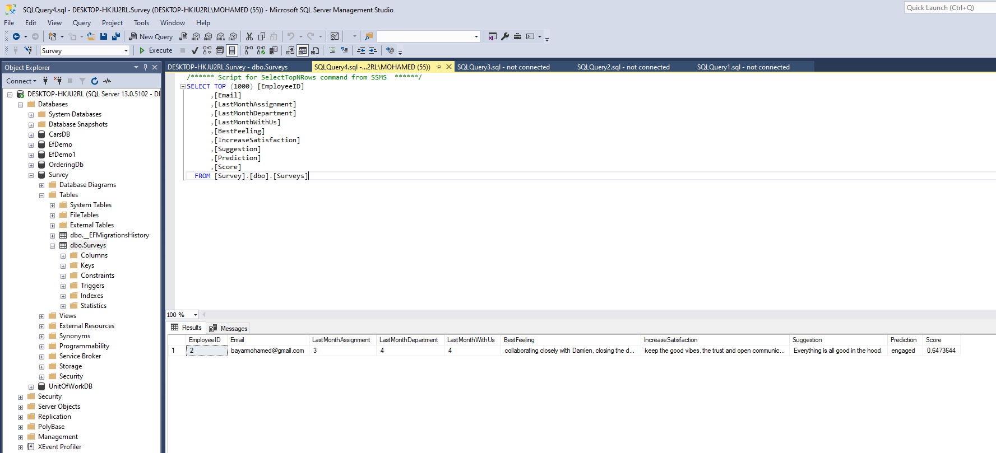
Save predicted surveys
sql server database is used to save predicted surveys

Slide 37
Questions
Kevin Albert: Data Scientist
Hanna Oulad: Web developer
Bayar Mohamed:
MS .Net Consultant

